Slide 1
Notes:
Presentation & Contents:
The Award, purposes, history and benefits
Our candidacy and 2024 programe

Slide 2
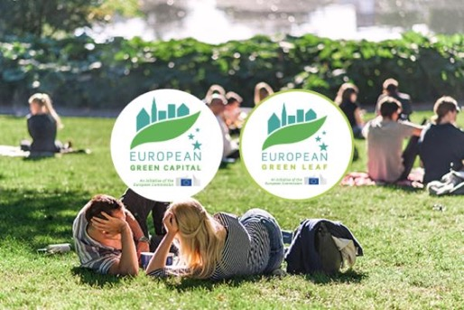
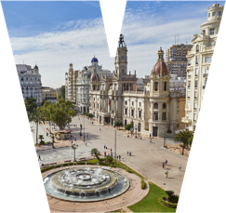
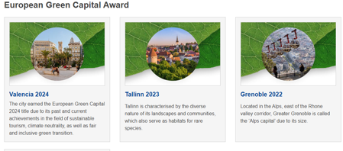
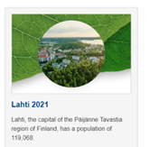
ABOUT THE AWARDS
Notes:
ABOUT THE AWARDS
Urban areas are the source of many of today’s environmental challenges – not surprisingly, since two out of three Europeans live in towns and cities. Local governments and authorities can provide the commitment and innovation needed to tackle and resolve many of these problems.
The European Commission’s green city awards include two titles. The European Green Capital (EGC) for cities over 100.000 habitants and the European Green Leaf (EGL) for smaller cities as of 20.000 habitants. The awards recognise and reward local action towards a transition to a greener, more sustainable future. Winning cities are including their citizens in this transition, improve the urban environment, combat pollution and mitigate and prepare for more resilience to climate change. A greener city is a place that attracts investors, tourists and provides a better quality of live for their citizens.
The awards give impetus to bolder actions and spur local pride. Frontrunning cities show us the way how the green transition can be done. We can all learn from them.
OBJECTIVES
Reward consistent efforts to achieve high environmental standards.
Encourage ambitious and continuous commitments to environmental improvement and sustainable development.
Provide a model to inspire other cities.
BENEFITS
Increase in tourism.
Media coverage worth millions of euros.
Increased networking and new alliances.
Greater attraction of investment and generation of employment.
Access to subsidies for environmental projects.
Pride among citizens.
Drive to continue improving.

Slide 3
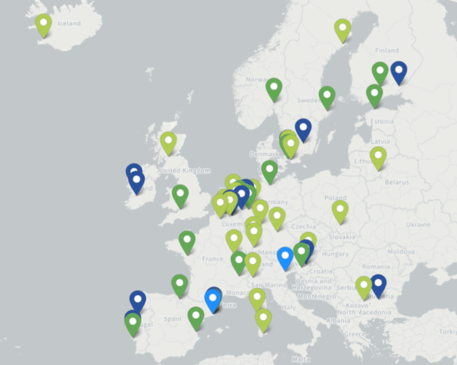
Notes:
EU GREEN CAPITAL NETWORK
During its European Green Capital Award-winning year in 2014, the city of Copenhagen created the concept of the European Green Capital Network, exclusively dedicated to the previous winners and finalists of the Award.
The Network members’ political commitment to put sustainability at the heart of local policies makes them strong advocates for impactful sustainable urban development in Europe. To this end, members of the Network do not only debate on best practices, challenges and potential solutions between each other, but they also encourage other European cities on their paths towards a more sustainable future by providing guidance and support.
The Network is chaired by the European Commission in close cooperation with the laureate city of the running year and automatically expands with each European Green Capital cycle.
All previous winners and finalists of the European Green Capital Award are eligible to become members of the network, contributing to and benefitting from the collective knowledge.
To this day, the Network counts 36 members, as follows: Amsterdam, Barcelona, Bristol, Brussels, Cagliari, Copenhagen, Dijon, Essen, Frankfurt, Freiburg, Ghent, Glasgow, Grenoble, Hamburg, Helsingborg, ‘s-Hertogenbosch, Krakow, Lahti, Lille, Lisbon, Ljubljana, Malmö, Münster, Nantes, Nijmegen, Nürnberg, Oslo, Reykjavik, Sofia, Stockholm, Strasbourg, Tallinn, Turin, Umeå, Valencia, and Vitoria-Gasteiz.

Slide 4
Notes:
HOW TO ACHIEVE THE AWARD?
The first exercise consisted of compiling the information, the data to complete the 12 indicators that make up the nomination.
In addition, an introductory document with general data on the city had to be submitted, another one in which 5 good practices in urban sustainability had to be selected and, as a novelty in the 2024 edition, a draft of the capital's program and its communication plan.

Slide 5
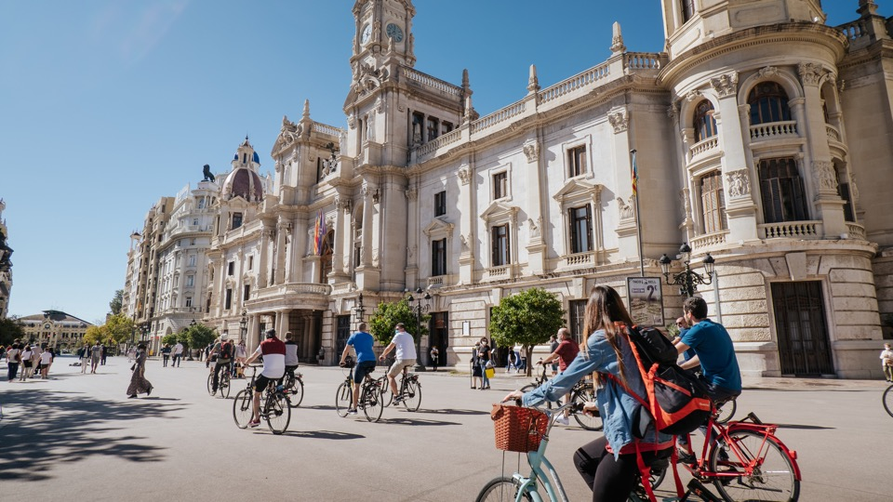
València, On A Mission Together
Notes:
THE CANDIDACY MOTO
As in the case of the city's own Urban Strategy, the Missions policy or the transformative projects, the Green Capital is seen as a collective journey, a shared objective, a project co-created between all the social and economic sectors of the city, between all the citizens.

Slide 6
Notes:
The efforts presented in València's candidacy were recognised by the jury in its decision.
The first Mediterranean city to become a model of urban sustainability for Europe.

Slide 7
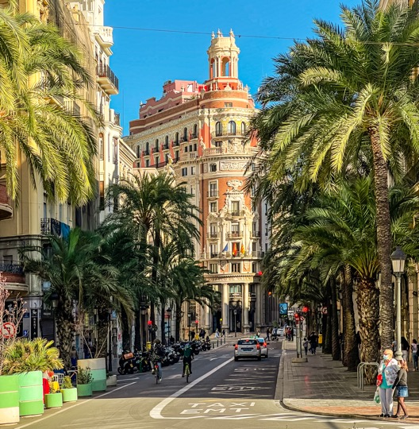
Past,
present,
and future
Notes:
Past, present and future of the city through 3 identity spaces that represent good practices in terms of sustainability and resilience.

Slide 8
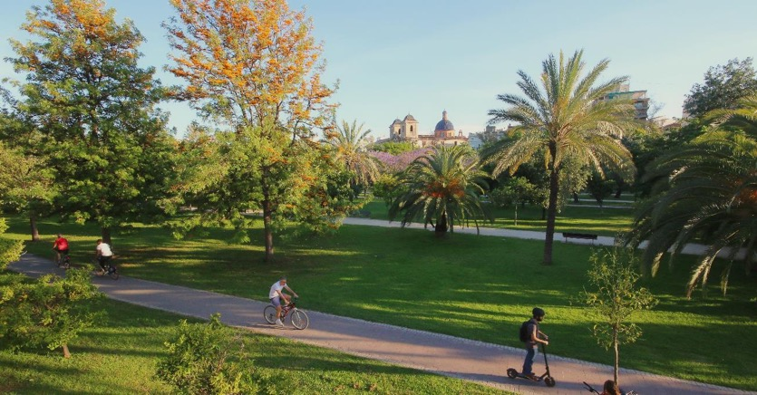
Turia
Gardens
Notes:
Los Jardines del Turia, uno de los principales refugios climáticos y activos de salud de València.

Slide 9
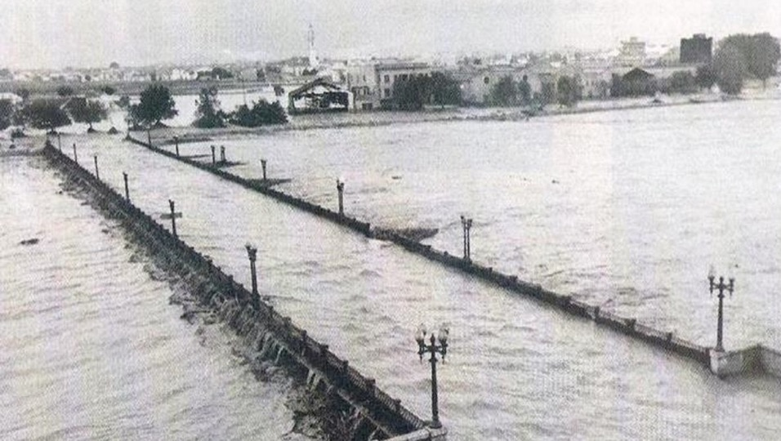
Recovery
after the flood
14th October 1957
Notes:
This large park is located on the old Turia riverbed, hence its name; the same riverbed that contributed to the huge flood that devastated the city in 1957, including lives and property. This extreme meteorological episode and its consequences led to the design and construction of a new course for the river through its southern periphery, opening the possibility of using the old course for other purposes.

Slide 10
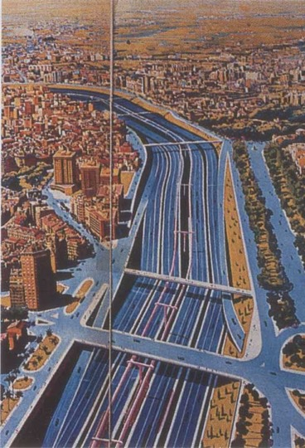
The river is ours and we want it green
Notes:
At that time, in the mid-1960s and in the midst of the dictatorship, when extreme developmentalism prevailed, it was planned to dedicate it to an urban motorway, a multi-lane beltway that would facilitate motorised traffic through the city.

Slide 11
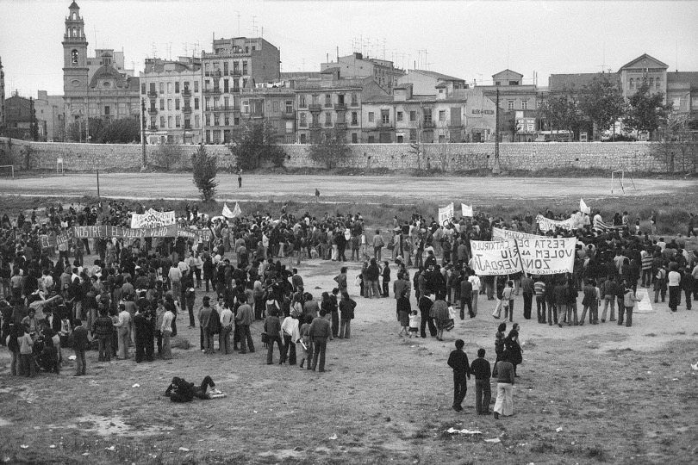
The river is ours and we want it green
Notes:
Fortunately, an active mobilisation of citizens expressed their opposition to the project under the slogan "El Cauce es nuestro y lo queremos Verde" (The riverbed is ours and we want it green).
With the arrival of democracy, the state ceded the land to the city and, in line with this demand, the land was classified as a green zone and public park. Thanks to those sensitive and fighting collectives, today we enjoy a large park.

Slide 12
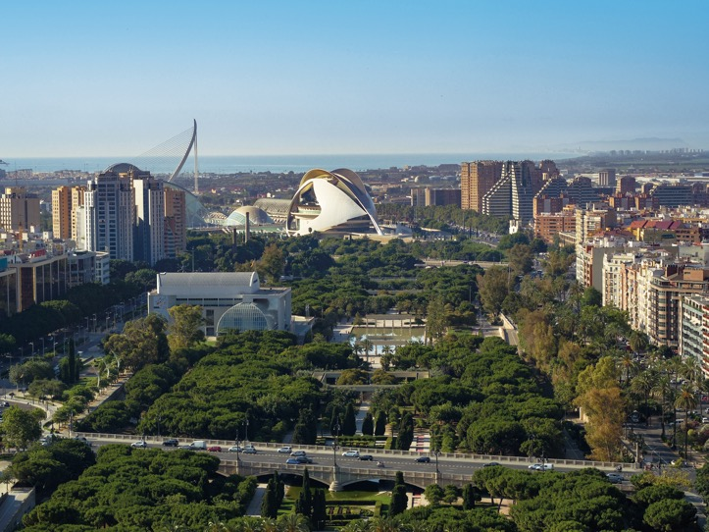
The largest urban park
in Spain
Notes:
With its 120 hectares, the Turia Garden is one of the largest and most visited urban parks in Spain.
It is, without a doubt, the city's largest green lung and a health and leisure asset for all kinds of public; at any time of day you can see joggers exercising, parents with children playing or celebrating birthdays, people walking their pets or those who use it as a connector to go on foot or by bicycle to their destination. And, of course, the many visitors who use it to tour the city, from the historic centre to the famous architectural ensemble that is the City of Arts and Sciences.
It will soon see its extension in the new Parque de Desembocadura, a new project that will regenerate the last stretch of the riverbed into a new green area that will restore its connection with the sea. The public tender is currently being processed to select the most suitable project to complete the largest urban park in our country.

Slide 13
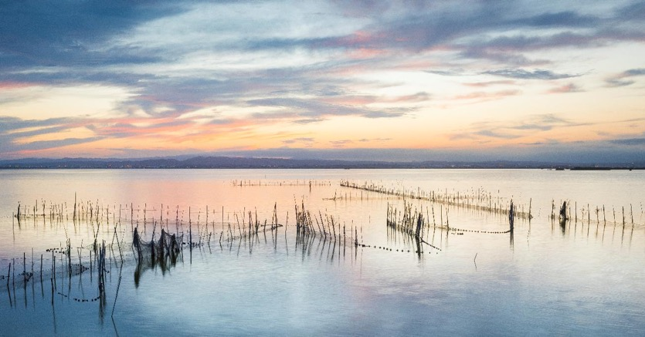
Albufera
Natural
Park
Notes:
La Albufera and its Devesa, another citizen mobilisation in the 1970s in defence of the territory.

Slide 14
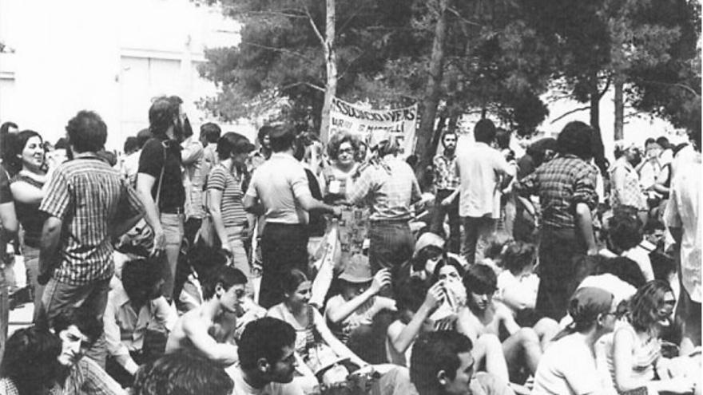
El Saler for the people
Notes:
In the 1960s, due to the dictatorship's obsession with the development of the then incipient tourism, a project for the total urbanisation of the Devesa (the wood that cercles the lake to the sea), including a concrete promenade and the construction of dozens of hotels and flat towers, was approved in 1965.
Valencian citizens, with some conservationist groups at the forefront, began a mobilisation that spread as the first developments of the project were carried out. In the mid-1970s, popular protest reached its peak and, under the slogan El Saler for the People, forced the cancellation of the project, the restitution of public property and set in motion the reversion of the destiny of this natural space until it was declared a Natural Park in 1986.

Slide 15
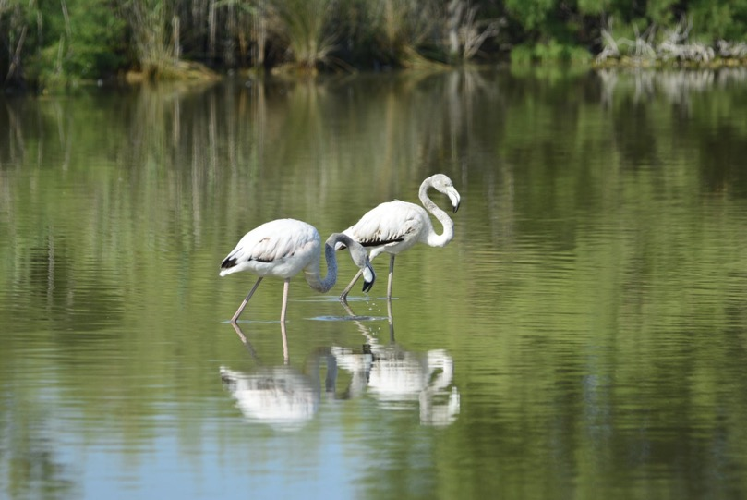
Flora and fauna of great value
Notes:
The Albufera lake and the Devesa de El Saler forest, the heart and most ecologically valuable enclaves of the Natural Park (Ramsar site and Natura 2000 Network).
It is a refuge, among others, for one of the largest colonies of aquatic birds in Spain.

Slide 16
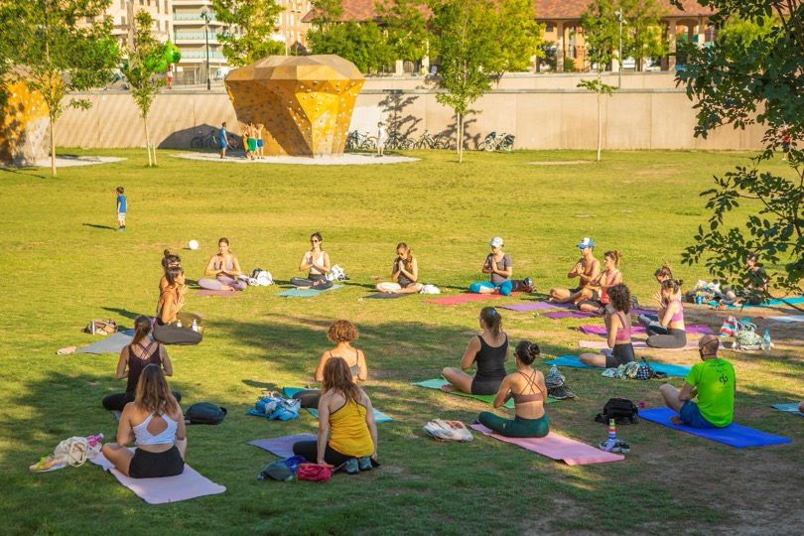
Our citizens live and interact
in València
Notes:
Ultimately, it is people who live, interact and thus create the city.
Our city model is based on the faithful conviction of placing people at the centre, as the beginning and end of all urban strategy processes.

Slide 17
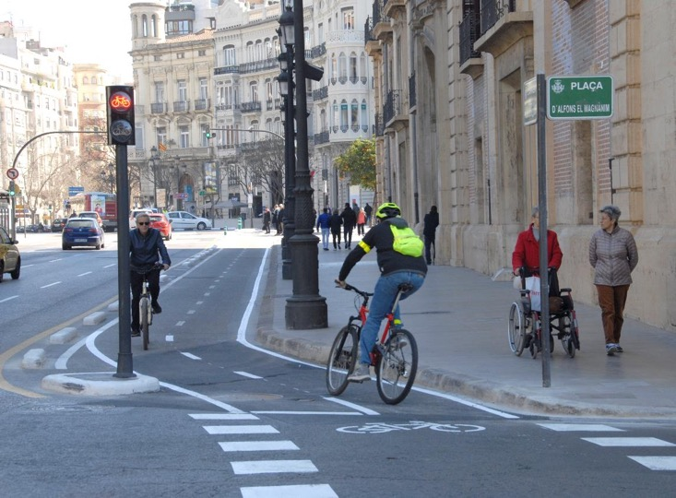
València
should be
created for and by them
Notes:
A city model tailored to people; by, for and with citizens: our Local Green Deal.

Slide 18
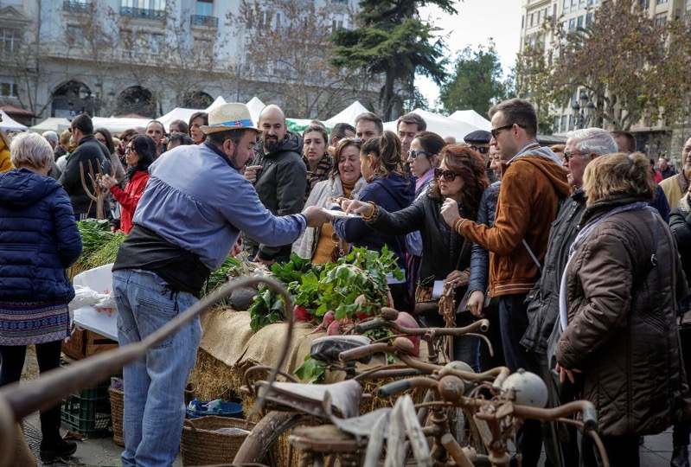
A city based on
Citizens’ demands and needs
Notes:
In a context of crisis such as the one we are experiencing, it is on people and their needs and expectations that we must move forward in our city model.

Slide 19
Notes:
Innovation is a core element of our city model, having been incorporated into the very core of the Urban Strategy through Missions València 2030.

Slide 20
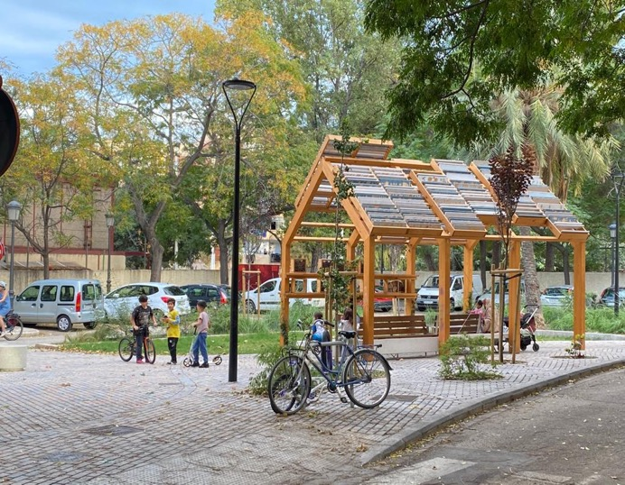
Notes:
The València 2030 Strategy's Views represent values and aspirations that mark the city's roadmap for this decade. A city that is attractive for people and talent, for its quality of life and healthy environment, for the social and professional development opportunities it offers.
A city that is innovative and creative, as well as inclusive and welcoming.
And finally, the Green and Sustainable City, resilient in the face of climate change, which has been able to defend its territory: Turia river, Albufera and orchard.
Committed to the Climate Mission and a fair energy transition, with responsible consumption and local and sustainable production.

Slide 21
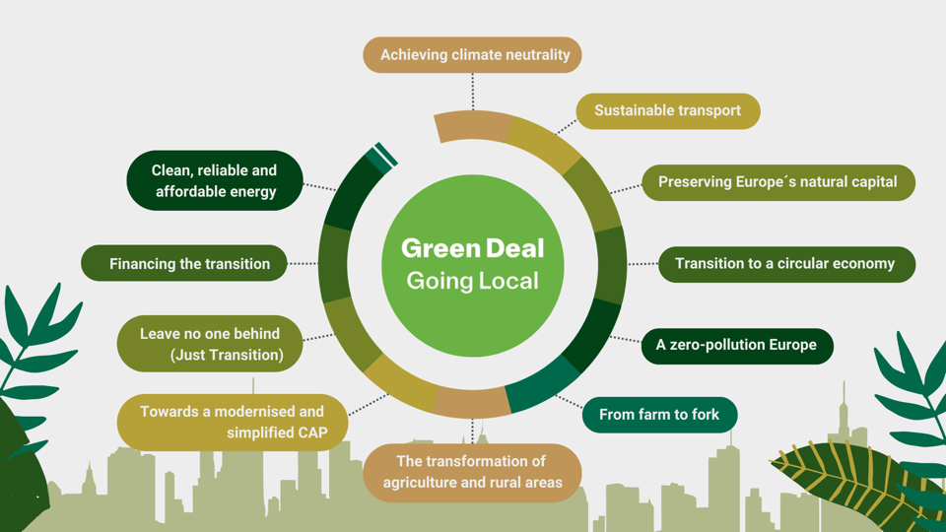
Notes:
The València 2030 Strategy provides the local and urban vision to advance integrally in each of the axes of the Green Deal, from sustainable mobility to the circular economy, from "from farm to fork" to clean, reliable and affordable energy.

Slide 22
ENERGY
CRISIS
ECONOMY
CRISIS
CLIMATE
CRISIS
Notes:
MAIN CHALLENGES
The current context forces us to overcome the climate, energy and economic crisis while being more social and supportive than ever, leaving no one behind in this unquestionable green transition. València aspires to be a refuge for the most vulnerable part of society.

Slide 23
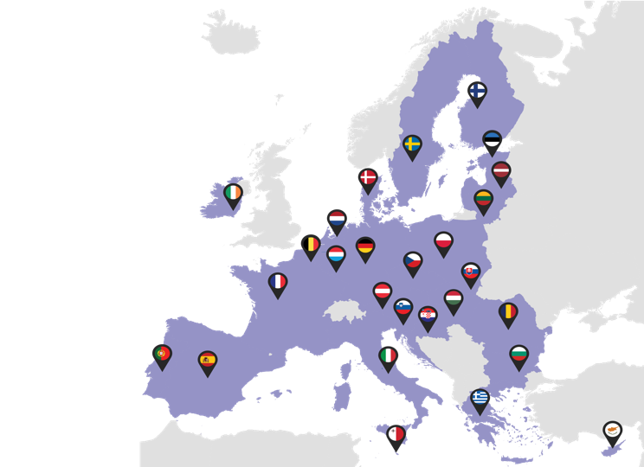
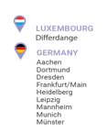
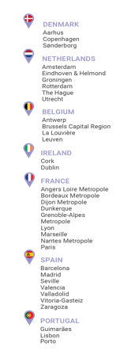
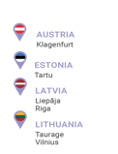
EU Cities
Notes:
València is one of the 112 cities (7 Spanish) selected by the European Commission in its 100 Smart and Climate Neutral Cities Mission, a choice that highlights the alignment of its urban strategy with the European green pact.

Slide 24
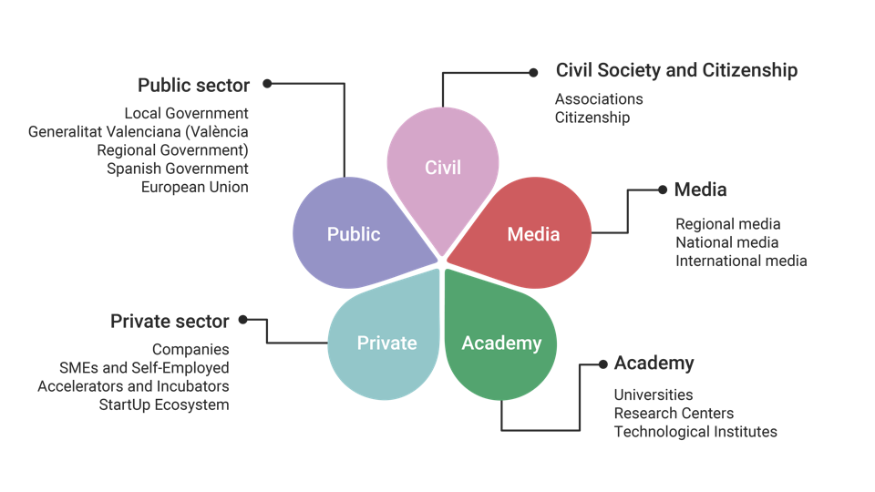
Notes:
The ambition and complexity of this roadmap requires the involvement of all possible actors through communication strategies and the participation of the 5 propellers of our ecosystem.

Slide 25
SUSTAINABLE MOBILITY & PUBLIC SPACE RECOVERY
RENATURATION & BIODIVERSITY
CLIMATE
MISSION
HORTA & SUSTAINABLE FOOD
Notes:
Axes and strengths for a European Green Capital Program
4 thematic axes bringing together the city's best practices in urban sustainability

Slide 26
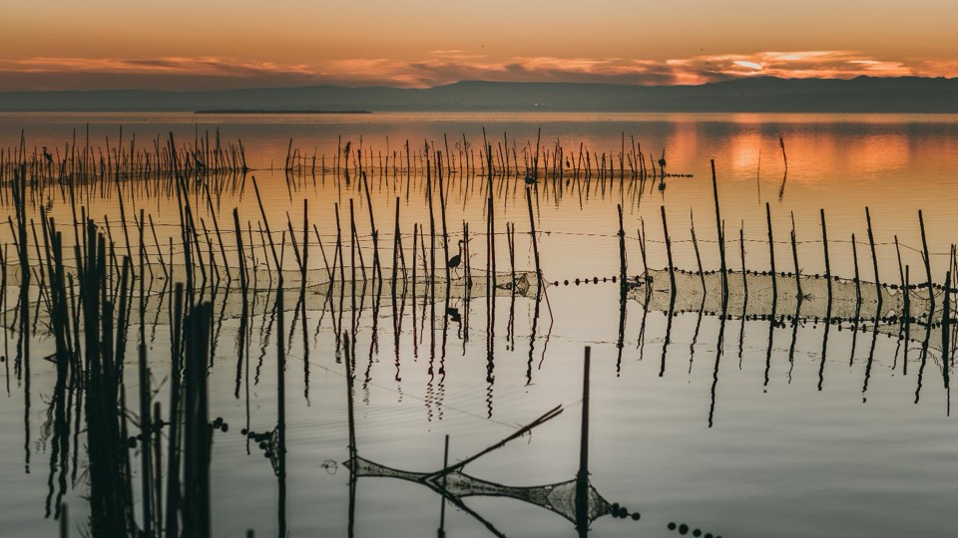
Renaturation & Biodiveristy
Highly relevant natural assets
Notes:
On nature and biodiversity

Slide 27
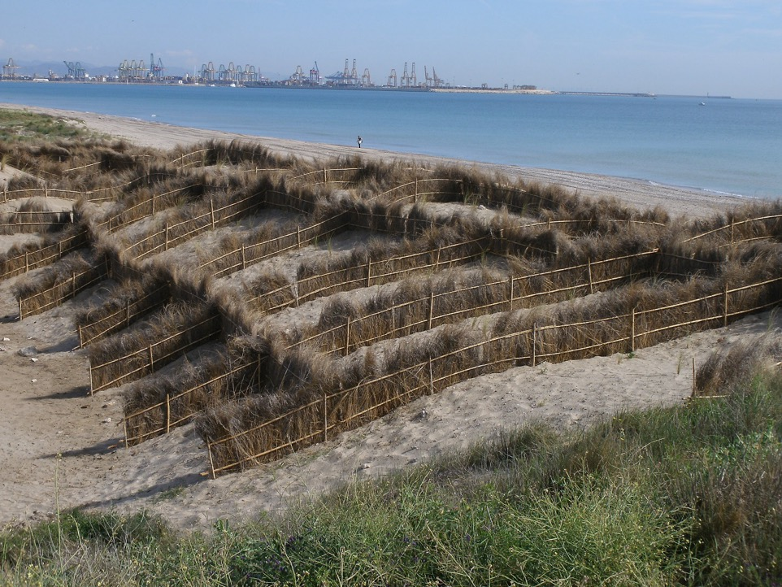
2 decades of experience in various dune restoration projects
Notes:
To highlight the restitution of the dunes of the Saler beaches, their natural habitats and their biodiversity along 14 kilometres of coastline.

Slide 28
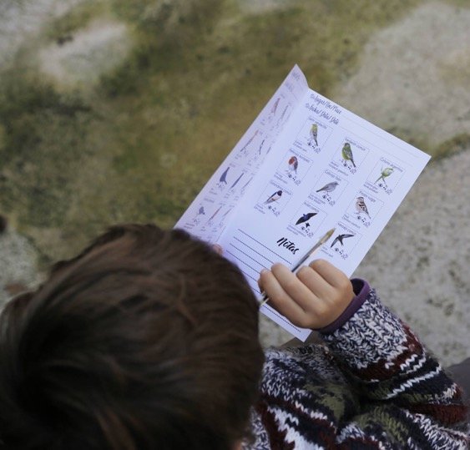
GREEN AND BIODIVERSITY PLAN
What?
Strategic document to guide municipal management of green infrastructure, natural heritage and urban biodiversity in the coming decades.
Targets?
Informal, organized and expert citizenship.
How?
‘Leading group’
Open calls for neighbors, educational centers, etc.
Photography contests.
Hackathon: Towards green.
Notes:
The Green and Biodiversity Plan, a new strategic document that will guide the management of green infrastructure, natural heritage and urban biodiversity in the coming decades, with an emphasis on the recovery of ecosystem processes, environmental services, system connectivity and biodiversity.
The city has two natural parks and more than 650 ha of urban green spaces; more than 7 m2/inhabitant by 2020 and a target of 10 m2 in the near future (although 24 neighbourhoods already have values above this ratio). 200,000 trees and an aspiration to achieve one tree for every 2 inhabitants.

Slide 29
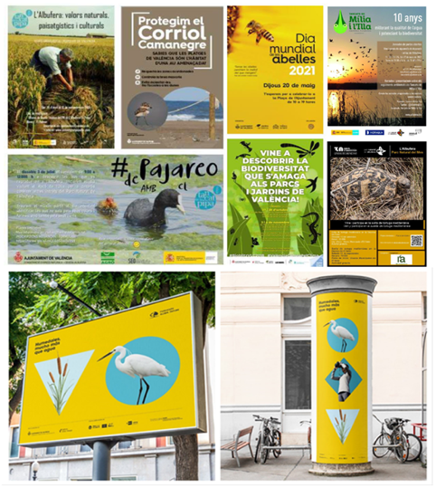
AWARENESS CAMPAIGNS
What?
Numerous awareness-raising and dissemination campaigns on the need for conservation and recovery of our main ecosystems and natural assets.
Targets?
Citizenship of València.
How?
L'Albufera: natural, landscape and cultural values.
Protecting the Kentish Plover.
World day of the bees.
Birdwatching.
Wetlands much more than water.
Notes:
The conservation of these natural spaces is developed with the participation of the public through information, communication, development of monitoring activities and environmental restoration.

Slide 30
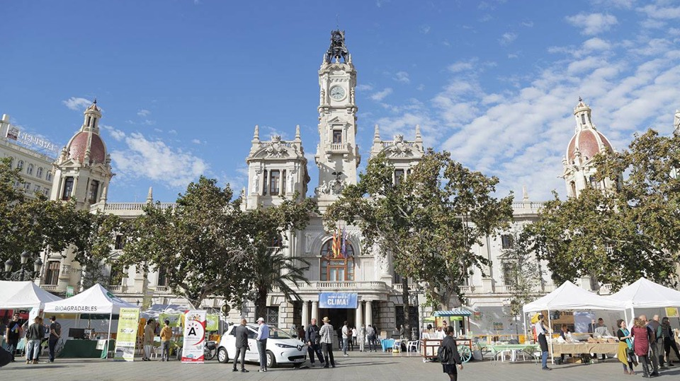
Climate Mission
Fair energy transition
Notes:
València has a Climate and Sustainable Energy Action Plan based on the principle of climate justice.
The city has already reduced its emissions by 30.9% and has drawn up its City Climate Contract which has been signed with the EC within the framework of the European Climate Mission.

Slide 31
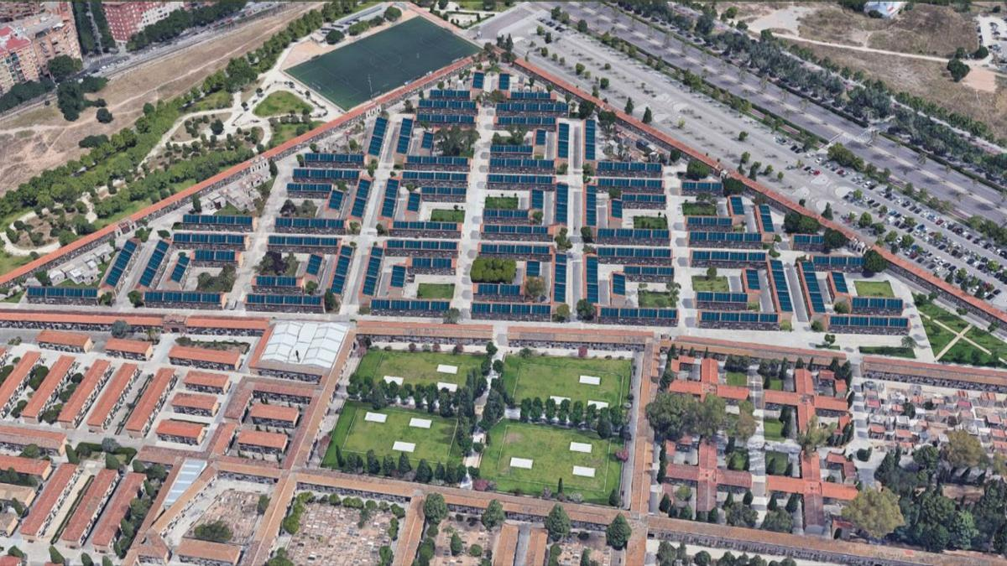
Réquiem in Power
Largest public urban solar power plant in Spain
Notes:
In this respect, the creation of the largest public urban solar plant in Spain has been launched. The project (R.I.P.) involves the installation of 7,000 solar panels on the roofs of the niches of the municipal cemeteries of Valencia;
2.8 million megawatts of power will be installed and the energy obtained will be used for self-consumption, but will also be offered to the public. Specially, families of lower incomes.

Slide 32
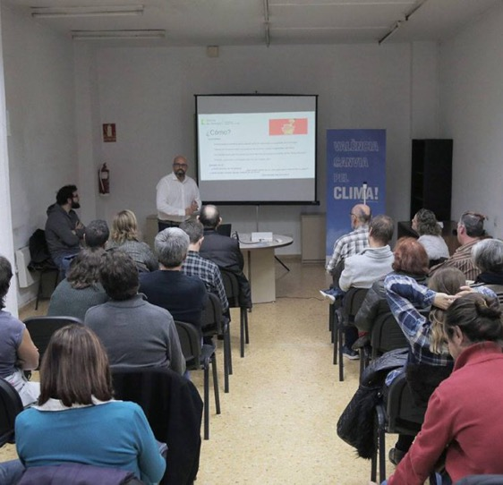
ENERGY OFFICES IN VALÈNCIA
What?
A network of energy advisory offices in the city, distributed among districts, fixed or itinerant, which act as the backbone of the energy transition in the city.
Targets?
Citizenship of València.
How?
Personalized guidance to analyze the electricity bills.
Tips for saving at home.
Information for the installation of renewable energies.
Notes:
Since 2019, València City Council has been deploying a network of energy advice offices in the city, a citizen service to inform, advise and accompany citizens and the city's ecosystem on energy issues: the right to energy, energy efficiency, renewable energies andenergy culture..

Slide 33
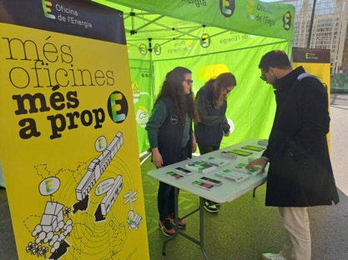
Learnings
There is a significant lack of knowledge on energy issues among citizens, which has economic, environmental, etc., repercussions.
Behavioural change
By providing citizens with information, support and tools in the field of energy culture, we achieve that people can take an active role in the city's energy transition.
Replicability
We provide numerous materials in the form of guides, information brochures, etc. on how to bring energy issues closer to the public in a simple way.
Notes:
More than 35,000 attended since their opening

Slide 34
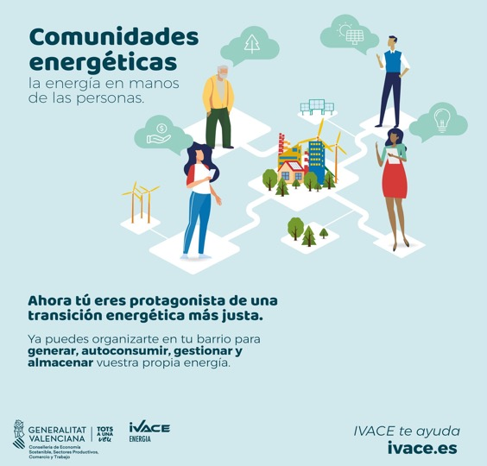
NEIGHBORHOOD
ENERGY
COMMUNITIES
What?
Non-profit entities, with open participation and social and environmental purposes, that allow citizens to collaborate with small companies and the public administration to share renewable energy resources and promote energy saving and efficiency habits and measures.
Targets?
40 families from the neighborhood of Castellar-l’Oliveral.
How?
Analysis of photovoltaic potential of city roofs.
Training of individuals and entities.
Notes:
Neighborhood Energy Communities to promote self-consumption.

Slide 35
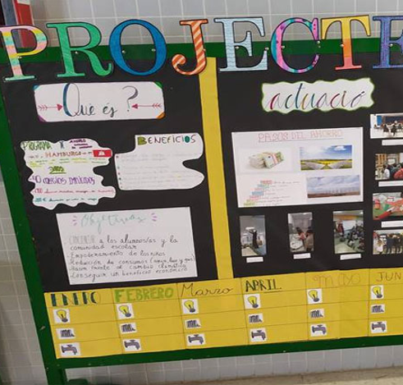
50/50
PROGRAMME
What?
Measures and behaviours program assumed by the entire educational community, aimed at saving energy, both in lighting and heating, saving water, and reducing CO2 emissions and, as a result of all this, also achieving economic savings.
Targets?
Elementary students from educational centers of València.
How?
Constitution of an energetic team in each center in which the students assume the leading role.
Dynamization of participatory and training processes
Notes:
School project to promote energy empowerment and energy efficiency and savings in the school population.

Slide 36
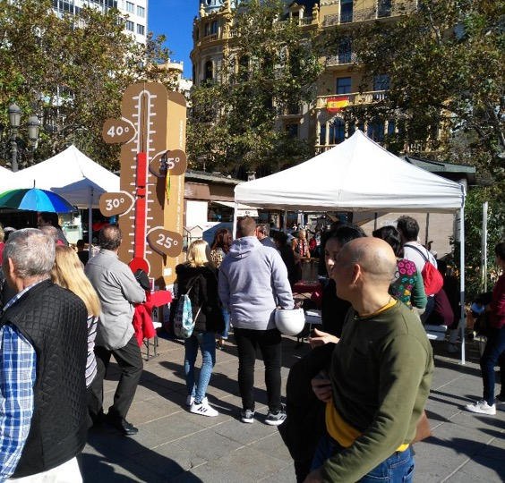
VALÈNCIA CANVIA
PEL CLIMA!
What?
Citizen awareness and sensitization initiative in relation to the energy transition and the fight against climate change in València.
Targets?
How?
Citizenship, institutional agents and experts.
Round tables.
Workshops.
Information points in emblematic places of the city.
Family oriented activities.
Notes:
València Canvia pel Clima! Public meeting to share all the initiatives that are being developed in the city to tackle climate change.

Slide 37
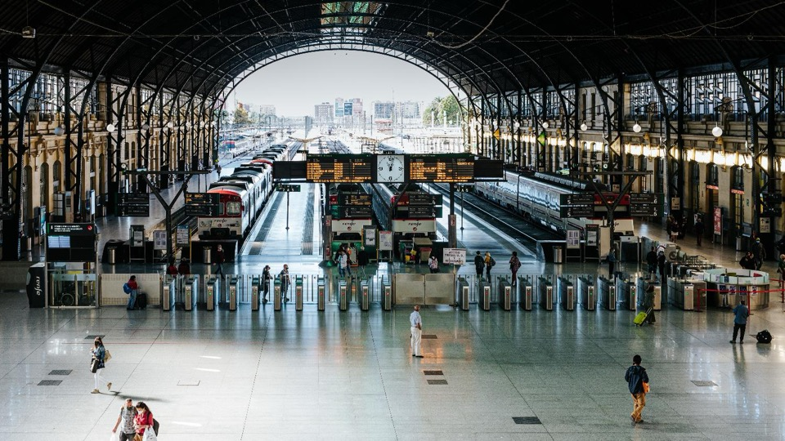
Sustainable Mobility & Public space recovery
Decarbonization of mobility
Notes:
The transition to sustainable mobility is one of the biggest collective challenges facing cities around the world; its impacts and co-benefits are enormous.

Slide 38
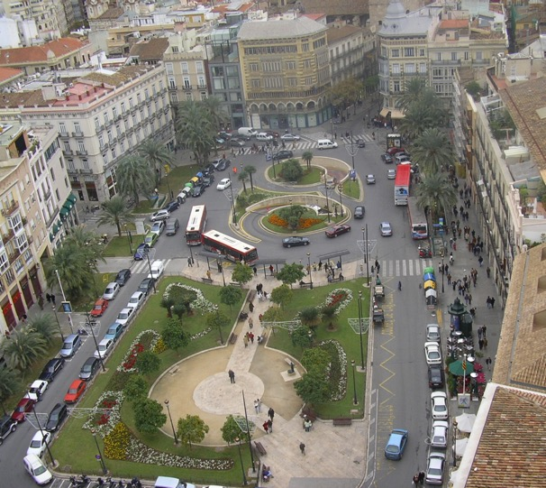
Pedestrianizing the city

Slide 39
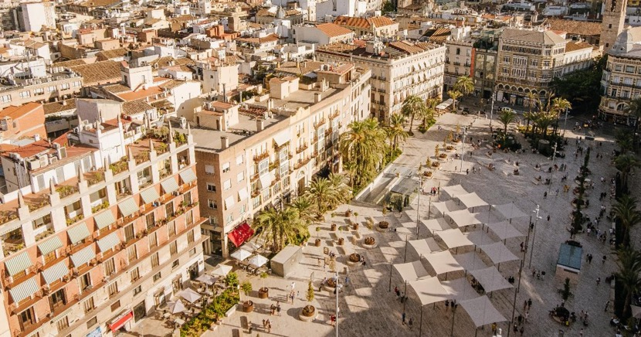
The Queen’s square

Slide 40
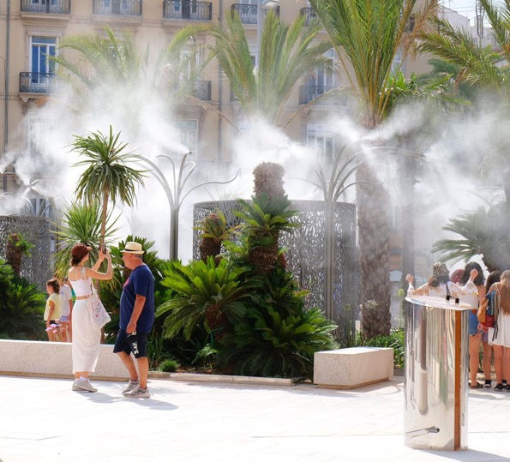
Result of a citizen participation process

Slide 41
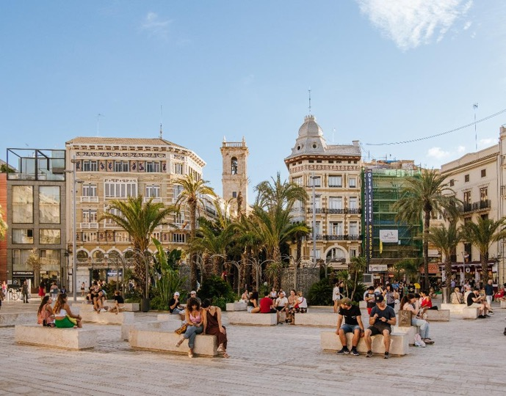
Pedestrian and cycling revolution

Slide 42
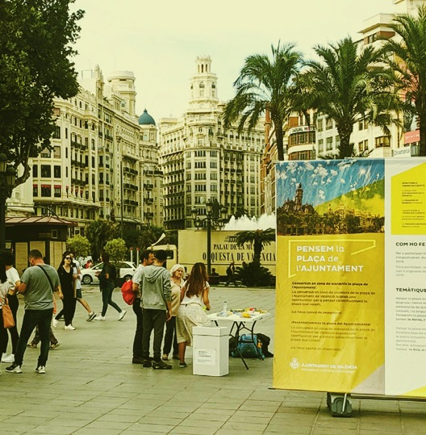
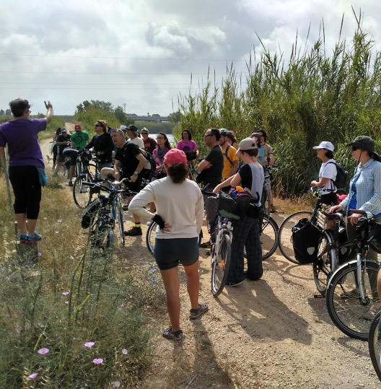
PENSEM LA PLAÇA - LET´S THINK OUR MAIN SQUARE
What?
Open call in the form of a competition to select the project responsible for the drafting of the basic project, execution and construction management of the pedestrianization of the Town Hall Square.
Targets?
Anyone interested.
How?
Results of the process:
More than 1,800 opinions have been collected from 33 entities by a joint and multidisciplinary jury.
5 finalist ideas.
cinc
Notes:
Particularly relevant has been the process for the pedestrian recovery of what is perhaps the most iconic square in our city: the Town Hall Square.
We decided that the reimagining of this space could not be solely the result of a municipal decision and, therefore, we launched the participatory process Pensem la plaça. This is a public ideas competition with which we have created the definitive design for this space. To this end, a joint, multidisciplinary jury has been set up to select the winning proposal.

Slide 43
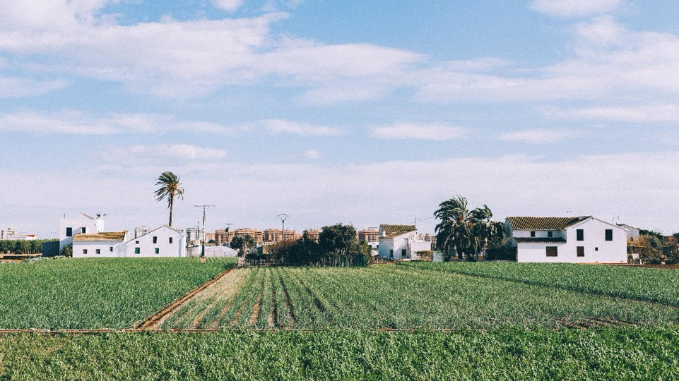
Horta & Sustainable Food
Fair agro-ecological transition
Notes:
And, finally, if there is one thing that distinguishes us in Valencia, it is our Huerta.
València has grown at the expense of its huerta until social demand led to its definitive protection. Today it is a valuable asset of sustainable, healthy and local food (pandemic).

Slide 44
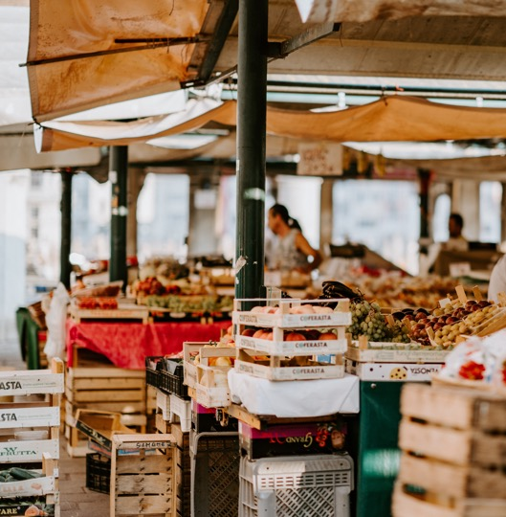
NEIGHBORHOOD AND FOOD PROGRAM
What?
Program aimed at promoting community action projects in the neighborhoods of València for the promotion of healthier, sustainable and inclusive food environments.
Targets?
Citizenship of València.
How?
Community meetings between associative fabrics of the neighbourhoods.
Line of public tender subsidies for the presentation of community action projects, actions or initiatives that promote healthier and more sustainable food environments in the neighborhoods of València.
Notes:
Barris i Alimentació, an initiative aimed at promoting community action projects in València's neighbourhoods to foster healthier, more sustainable and inclusive food environments.

Slide 45
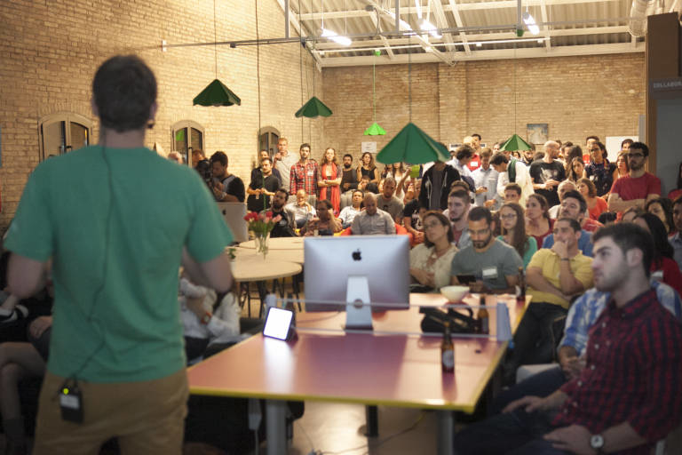
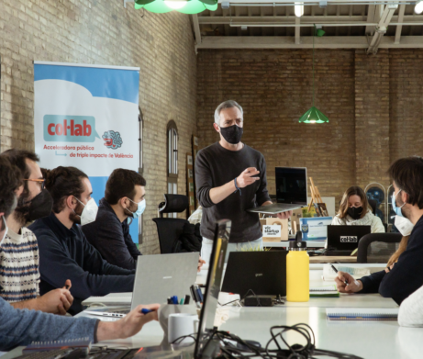
VLC
Tech City
A dynamic entrepreneurship ecosystem
Notes:
And in the face of the economic crisis, the firm commitment to consolidate a highly dynamic entrepreneurial ecosystem; in fact, Valencia is the city with the most start-ups per capita in Spain.
Every year, 100 new start-ups are created in the city, and it holds around 100 events on entrepreneurship, emerging technologies and innovation every year.

Slide 46
2024: EUROPEAN GREEN CAPITAL YEAR

Slide 47
Getting all the citizens involved in this collective journey
Acting as a lighthouse, inspiring other cities in the European Community
Generating and reinforcing local communities and alliances for a sustainable and ecological transition
Notes:
COMMUNICATION TARGETS

Slide 48
Neighbourhood Associations
Parents
Kids &
Families
Fallas Associations
Grandparents
Citizens
Network of other Associations
Schoolchildren
Non university audience
Startups
Youth
Erasmus
With a gender perspective
With a European perspective
With functional diversity perspective
Technological Institutes
Business
University Students
SMEs

Slide 49
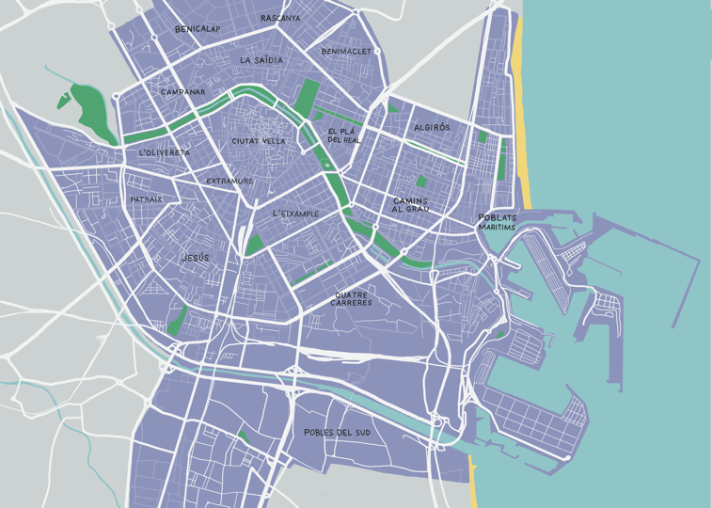
NATURAL SCIENCE MUSEUM
HUBs
VALÈNCIA INNOVATION CAPITAL
NATURIA
CITY OF ARTS AND SCIENCES
CEMAS
Notes:
GREEN CAPITAL HUBS

Slide 50
2024, A YEAR TO MAKE THINGS HAPPEN

Slide 51
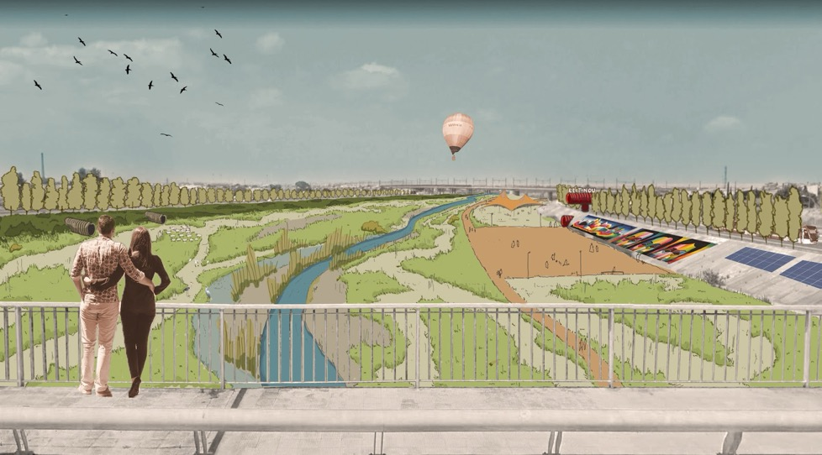
New Turia Riverbed
Notes:
RENATURATION & BIODIVERSITY

Slide 52
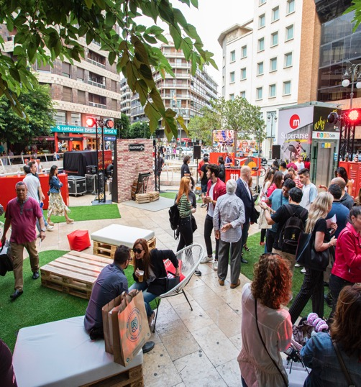
MY NEIGHBOURHOOD IN TRANSITION
What?
Participatory workshops held in different neighbourhoods where inhabitants will be able to express their needs and their vision on how their own space should be transformed and decarbonized.
Objectives?
Create ownership of the climate mission by the citizens.
Gather ideas around the energy transition.
Targets?
Citizens.
Neighborhood communities.
Notes:
PORTADA

Slide 53
MISSION CITIES FORUM
What?
We have organize a forum through the NZC and citiES 2030 platforms to join the 112 European Mission Cities and its local ecosystems in València.
The forum will be horizontal and aiming to create alliances between cities, citizens and ecosystems. Different activities, expert panels from cities, round tables, citizen dialogues, etc.
Objectives?
Strengthen European momentum on Mission Cities
Create awareness around the energy transition.
Convey the vision of the challenge as an opportunity for green jobs and other co-benefits.
Targets?
112 European Mission Cities & ecosystems.
Citizens, neighborhood&ecological associations.
Local energy communities.
Notes:
PORTADA

Slide 54
SUSTAINABLE "FALLAS"
What?
Action Plan to incentivate Sustainable Fallas and take them on the path of climate neutrality.
Objectives?
Transmite sustainabilities values.
Divulge the importance of the importance of been environmentally responsible.
Targets?
Fallas Associations.
Notes:
PORTADA

Slide 55
Project objectives
Enhance the value of the green spaces in the Campanar neighbourhood
Encourage their protection and responsible use by the citizens
Creation of a public policy proposal to help improve and adapt these spaces to the needs of the population.
Singularity
Citizens evaluate themselves and propose alternatives to improve the use of their own green spaces
Pilot experience of citizen participation transferable to other municipalities and applicable to other types of public policies
Implementation of citizen proposals extracted from the participatory evaluation process itself.

Slide 56
Identification of stakeholders
Actions of critical analysis with the citizens and stakeholders identified
Analysis and systematisation of the information collecte
Proposals for improvement and interventions on the green spaces of the neighbourhood.
Participatory evaluation
Actions carried out
Identification of tree species
Design of green routes

Slide 57
Launching of the advertising campaign València Green Capital 2024 Finalist
October 2022
Notes:
The warming up

Slide 58
Notes:
PORTADA

Slide 59
Notes:
PORTADA

Slide 60
Notes:
PORTADA

Slide 61
Gracias
Gràcies
Thank you
Grazie
Merci
Notes:
PORTADA

